Slide 1
ELE FOODS eat . love . enjoy
by
Pasupuleti Sri Harsha
Konduru Pravallika
Swati Guptha
Notes:
This template can be used as a starter file for presenting training materials in a group setting.
Sections
Right-click on a slide to add sections. Sections can help to organize your slides or facilitate collaboration between multiple authors.
Notes
Use the Notes section for delivery notes or to provide additional details for the audience. View these notes in Presentation View during your presentation.
Keep in mind the font size (important for accessibility, visibility, videotaping, and online production)
Coordinated colors
Pay particular attention to the graphs, charts, and text boxes.
Consider that attendees will print in black and white or grayscale. Run a test print to make sure your colors work when printed in pure black and white and grayscale.
Graphics, tables, and graphs
Keep it simple: If possible, use consistent, non-distracting styles and colors.
Label all graphs and tables.

Slide 2
Objective
To design a Full-Stack Web application for a Restaurant “ELEFoods” which is located at various locations and has various food items concerned with each location separately where admin can add and remove the food items for their specific locations and customer can order the food items.
Notes:
Give a brief overview of the presentation. Describe the major focus of the presentation and why it is important.
Introduce each of the major topics.
To provide a road map for the audience, you can repeat this Overview slide throughout the presentation, highlighting the particular topic you will discuss next.

Slide 3
Technologies
Angular -8
HTML-5 & CSS-3
Java -1.8
Spring Boot -2.3.3
Maven -4.0.0
Spring Data JPA -2.2.6
Hibernate -5.2.1
Oracle -11g
Notes:
Give a brief overview of the presentation. Describe the major focus of the presentation and why it is important.
Introduce each of the major topics.
To provide a road map for the audience, you can repeat this Overview slide throughout the presentation, highlighting the particular topic you will discuss next.

Slide 4
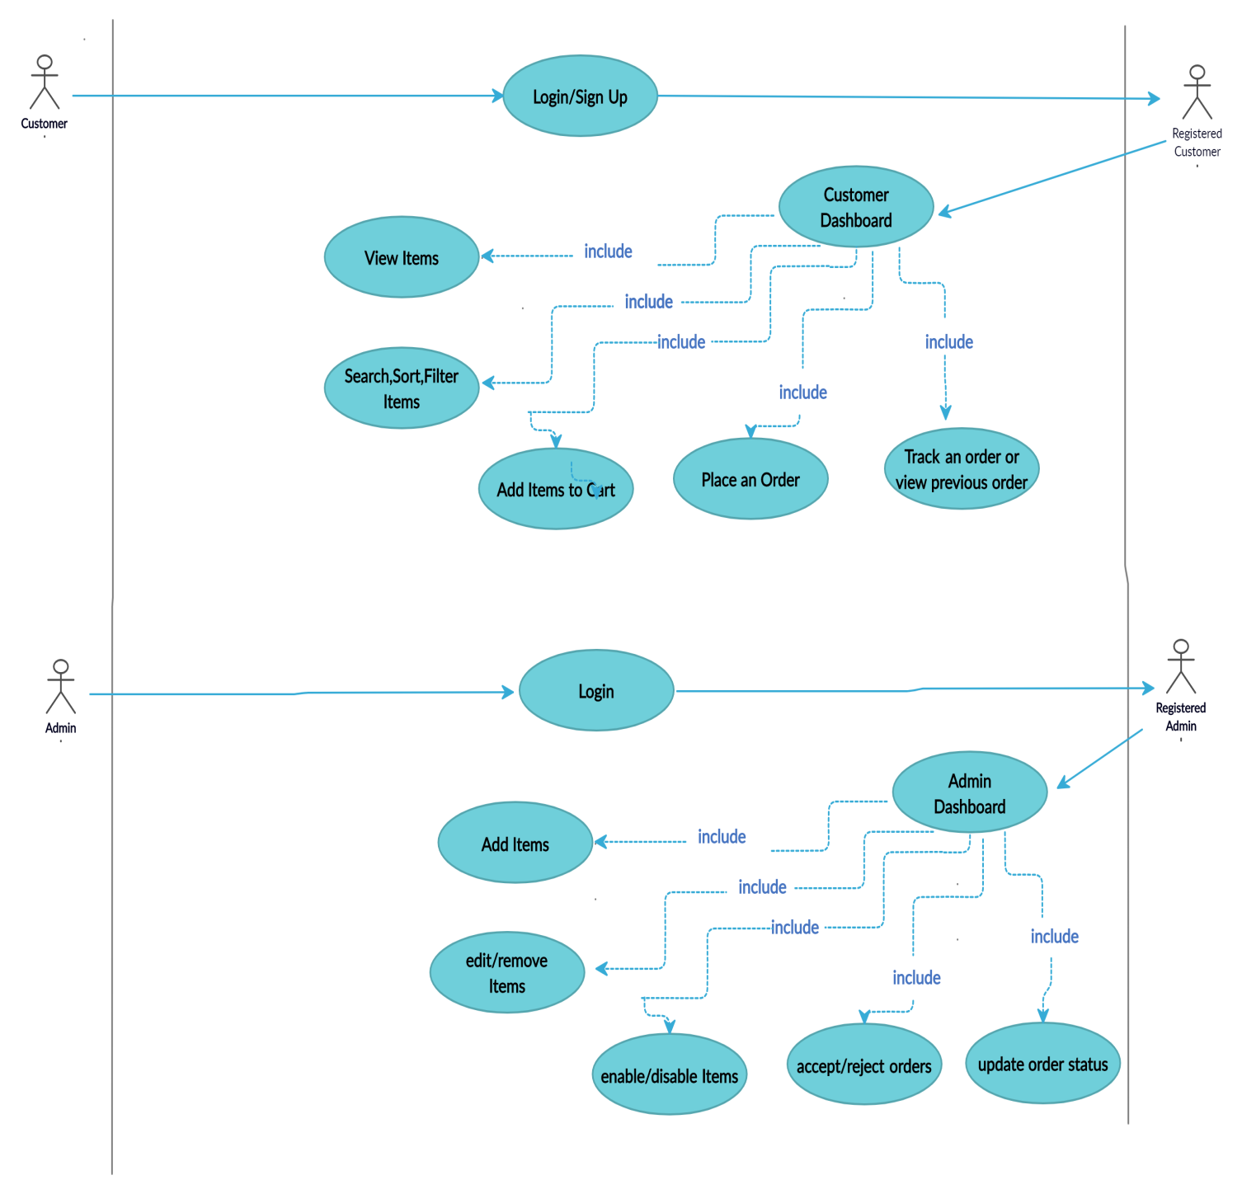

Slide 6

CLIENT LAYER
(User Interface)
USER
FRONTEND
BACKEND
ADMIN SERVICE
AUTHENTICATION SERVICE
CUSTOMER SERVICE
ADMIN SERVICE
AUTHENTICATION SERVICE
CUSTOMER SERVICE
DATA BASE
DATA BASE
DATA BASE

Slide 7
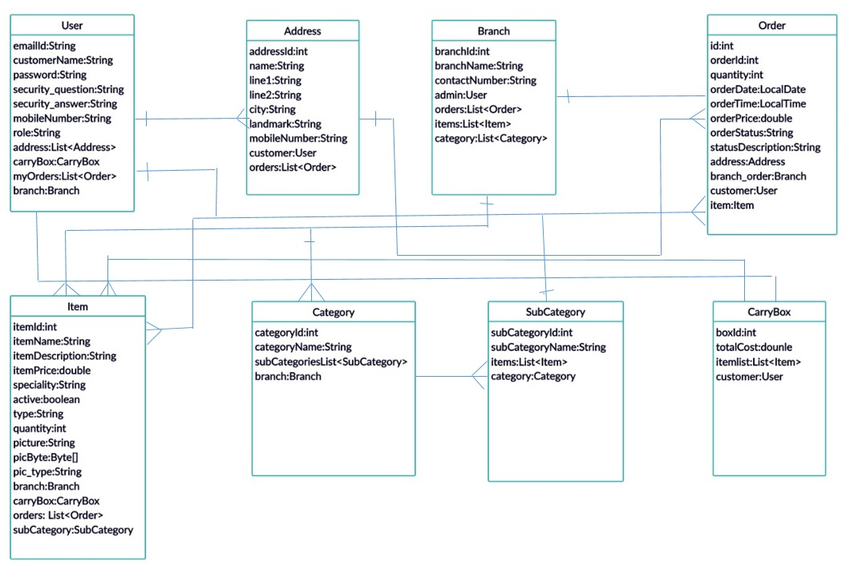

Slide 8
Future Scope
Social Media Integration
Deploying it into the server
Linking it to the real banks & UPI payment services

Slide 9
Thank You
Notes:
Is your presentation as crisp as possible? Consider moving extra content to the appendix.
Use appendix slides to store content that you might want to refer to during the Question slide or that may be useful for attendees to investigate deeper in the future.

